Slide 1
Radio Astronomy Telescope: Front End Electronics
(Part 1) Introduction to the BURSTT front end electronics
Phan Thanh Hien, July 2025

Slide 2
Objective
To provide students with the foundational understanding of each component in a standalone LPDA-based radio telescope. This lecture directly prepares them for the hands-on project, emphasizing the unique characteristics of this type of antenna.
Hands-on activities: the BURSTT system.

Slide 3


Slide 4

Dải Ngân Hà Trên Đỉnh Núi Tuyết. Tác giả: Lưu Hoài Nam. Địa điểm: Gunma, Nhật Bản.

Slide 5
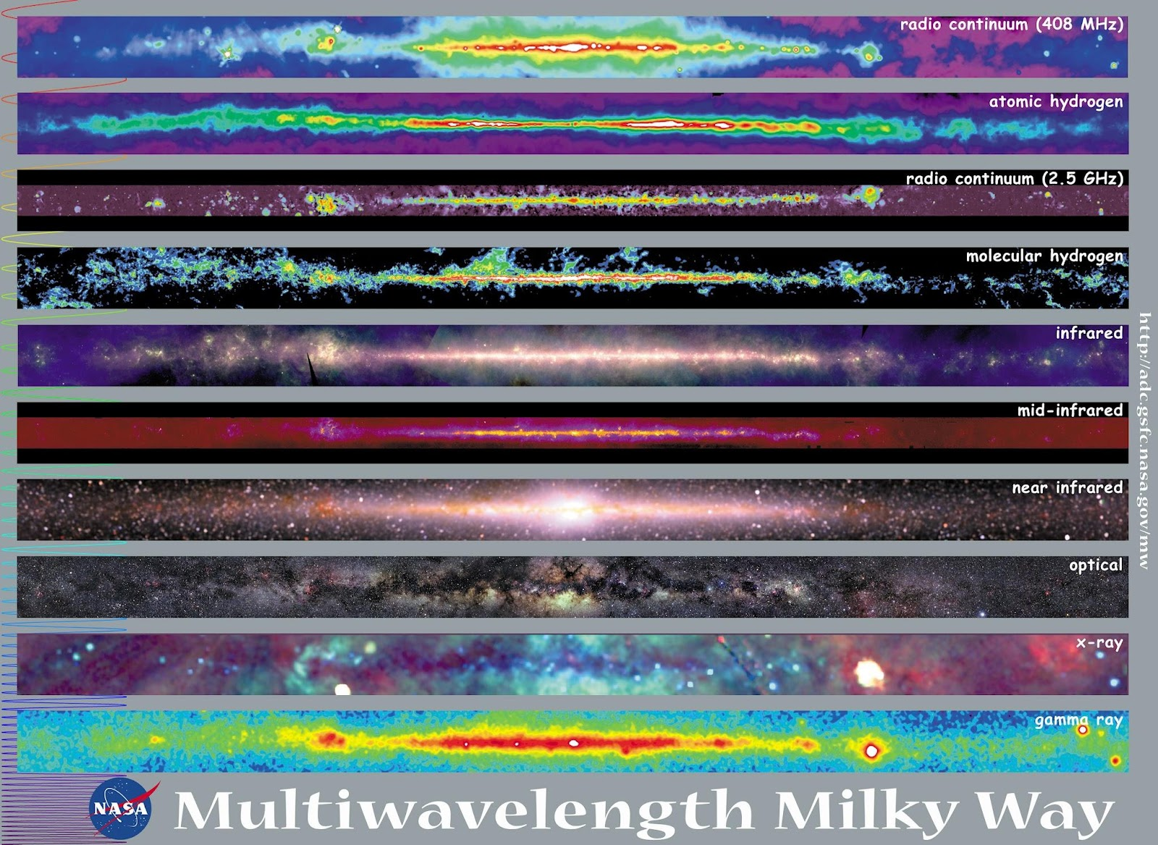

Slide 6
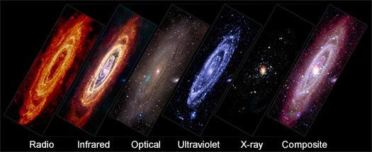
The Andromeda Galaxy (M31) in Different Types of Light.
X-ray: NASA/CXO/UMass/Z. Li & Q.D. Wang, ESA/XMM-Newton; Infrared: NASA/JPL-Caltech/WISE, Spitzer, NASA/JPL-Caltech/K. Gordon (U. Az), ESA/Herschel, ESA/Planck, NASA/IRAS, NASA/COBE; Radio: NSF/GBT/WSRT/IRAM/C. Clark (STScI); Ultraviolet: NASA/JPL-Caltech/GALEX; Optical: Andromeda, Unexpected © Marcel Drechsler, Xavier Strottner, Yann Sainty & J. Sahner, T. Kottary. Composite image processing: L. Frattare, K. Arcand, J.Major

Slide 7
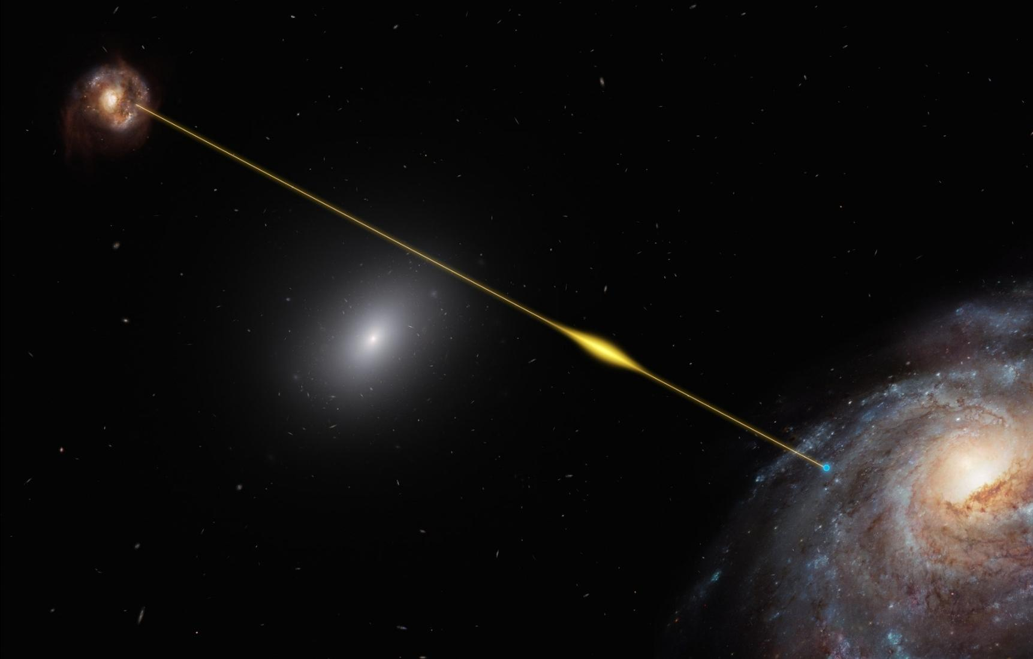
Fast Radio Bursts (FRBs)
A Fast Radio Burst is exactly what its name implies:
Fast: It is an incredibly brief event, lasting for only a few milliseconds.
Radio: It is detected only at radio frequencies, typically in the range of a few hundred MHz to a few GHz. It is completely invisible in optical, X-ray, or any other part of the spectrum.
Burst: It is an astonishingly powerful event. In the few milliseconds it is "on," an FRB can release as much energy as the Sun does in an entire day, or even more.
Image: A fast radio burst FRB 181112 as impressed by artist is on its way traveling through space and reaching Earth.
Credit: ESO/M. Kornmesser - https://www.eso.org/public/images/eso1915a/

Slide 8
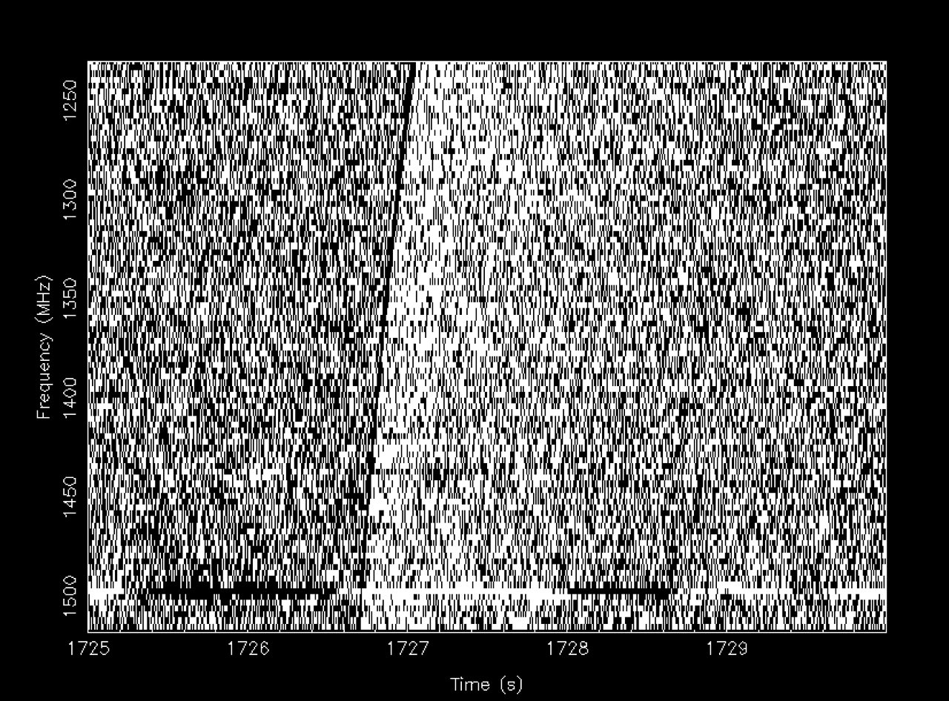
The Key Scientific Clue: Dispersion
This is the most important concept for understanding FRBs and proving they are not from Earth.
The Problem: The space between galaxies is not perfectly empty. It's filled with a very thin, tenuous plasma of free electrons.
The Effect: When a radio signal travels through this plasma, it undergoes an effect called dispersion. This means that lower-frequency radio waves are slowed down more than higher-frequency radio waves.
The Signature: When an FRB's signal arrives at our telescope, the high-frequency part of the burst arrives first, and the low-frequency part arrives a fraction of a second later. The signal is "smeared out" across the frequency band, arriving in a characteristic downward-sweeping pattern on a spectrum plot.
Image: The first detected fast radio burst (Lorimer et al. 2007).

Slide 9
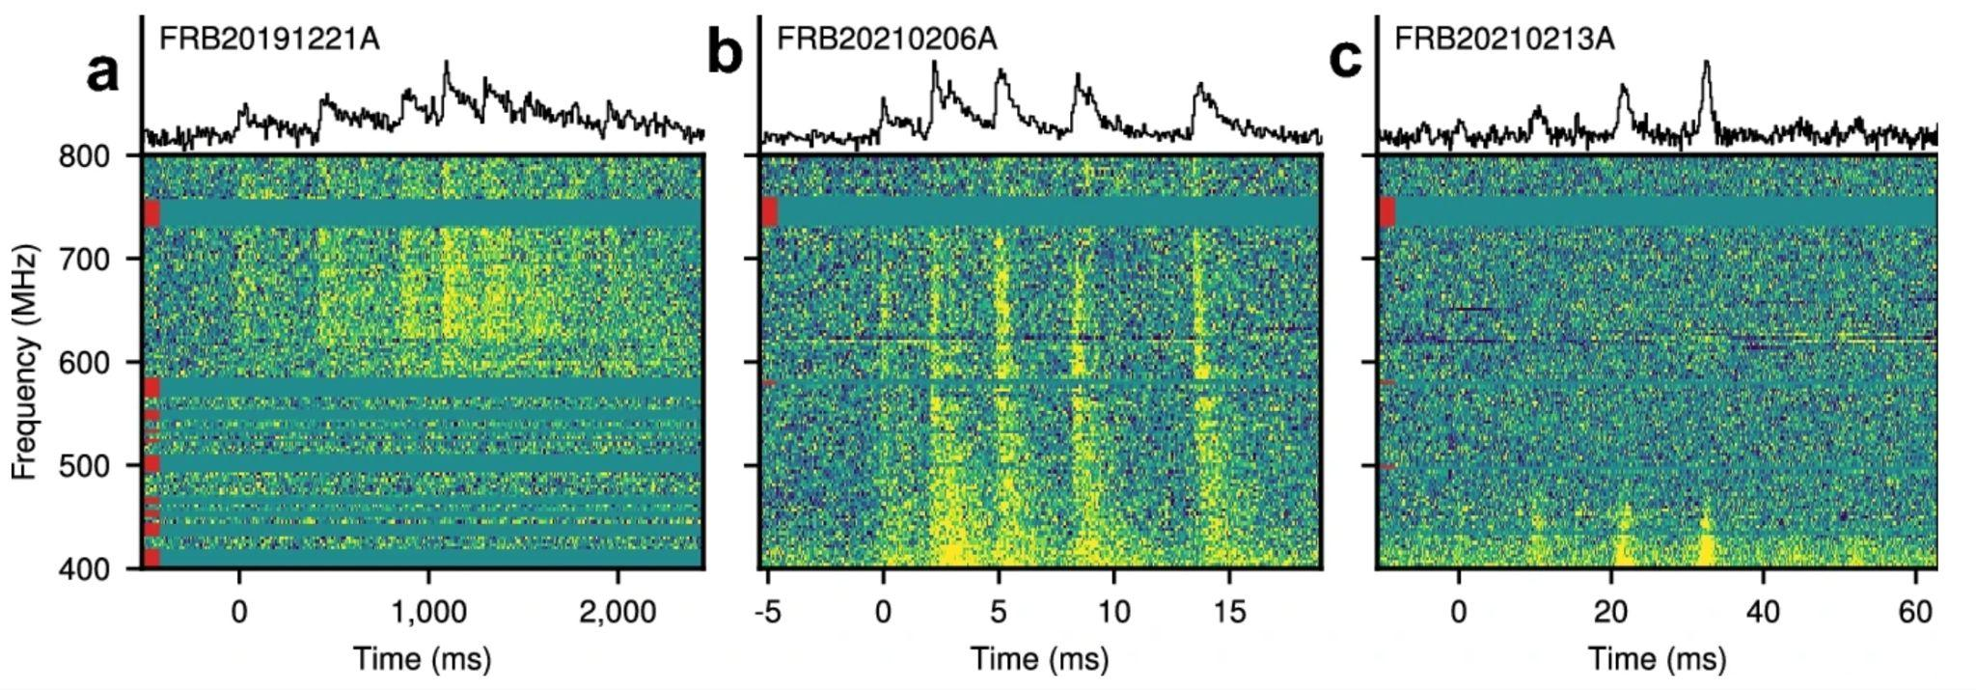
What Creates Them?
The leading candidates are all related to magnetars.
A Magnetar: A type of neutron star—the incredibly dense, collapsed core of a massive star after a supernova—with an impossibly strong magnetic field, trillions of times stronger than Earth's.
The Theory: A violent event on or near the magnetar, such as a "starquake" on its crust or a reconfiguration of its intense magnetic field, could release a massive burst of energy that we see as an FRB.
Some FRBs are seen to repeat, flashing multiple times from the same spot in the sky. Others have only ever been seen once.
Periodic and quasi-periodic bursts detected by CHIME/FRB. (https://chime-frb-open-data.github.io)
Left: FRB 20191221A lasting for nearly 3 seconds and showing 9 peaks separated by a strict period of 216.8 ms.
Middle and Right: FRB 20210206A and FRB 20210213A, show quasi-periodicities at 2.8 ms and 10.7 ms, respectively—though the statistical significance of these periods are marginal.
Petroff, E., Hessels, J.W.T. & Lorimer, D.R. Fast radio bursts at the dawn of the 2020s. Astron Astrophys Rev 30, 2 (2022). https://doi.org/10.1007/s00159-022-00139-w

Slide 10
How to detect them?
Single Dish Search
Large steerable dishes like the Parkes Telescope (Australia), the Green Bank Telescope (GBT) (USA), and FAST (China).
Point a single, very large, and very sensitive dish at one small patch of the sky and wait.
Advantage: High Sensitivity & Precision Localization.
Disadvantage: Tiny Field of View
Wide-Field Intensity Mapping
The CHIME Telescope (Canada).
Just stare at a huge swath of the sky 24/7 and use massive computing power to search the data in real-time.
Advantage: Massive Discovery Rate
Disadvantage: Poorer Localization
Interferometer Array Search
The ASKAP telescope (Australia) and MeerKAT (South Africa).
Use an array of many dishes spread out over a large area. Correlate the data from all dishes to search for bursts.
Advantage: The Best of Both Worlds.
Disadvantage: High Complexity.

Slide 11
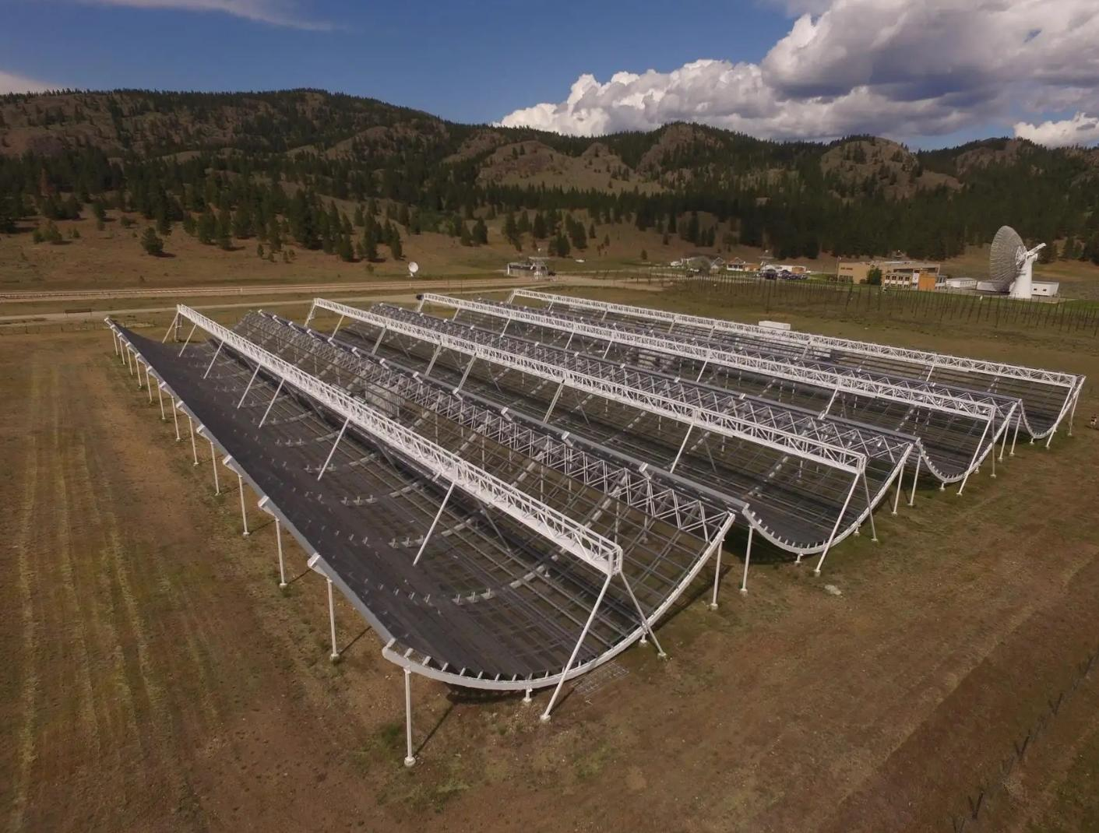
CHIME experiments
CHIME stands for the Canadian Hydrogen Intensity Mapping Experiment, located at the Dominion Radio Astrophysical Observatory (DRAO) in British Columbia, Canada.
It is not a traditional steerable dish. Instead, it looks like four giant, parallel snowboard half-pipes. Each "half-pipe" is a large parabolic cylinder, 100 meters long and 20 meters wide.
Along the focal line of each cylinder, there are 256 dual-polarization antennas, for a total of 1024 inputs.
Gigantic Field of View
Ideal Frequency Range: CHIME operates from 400-800 MHz.
24/7 Operation
Real-time Search
Notes:
The Radical Design: A Telescope with No Moving Parts
This is what makes CHIME so unique. It is not a traditional steerable dish. Instead, it looks like four giant, parallel snowboard half-pipes.
The Structure: Each "half-pipe" is a large parabolic cylinder, 100 meters long and 20 meters wide.
The "Antennas": Along the focal line of each cylinder, there are 256 dual-polarization antennas, for a total of 1024 inputs. These are the actual radio receivers that collect the focused waves.
How it Works (Scanning):
The long cylinders focus radio waves from a North-South strip of the sky.
The telescope is fixed to the ground and does not move. It uses the rotation of the Earth to scan a huge swath of the sky every single day. As the Earth turns, the sky drifts through CHIME's enormous field of view.

Slide 12
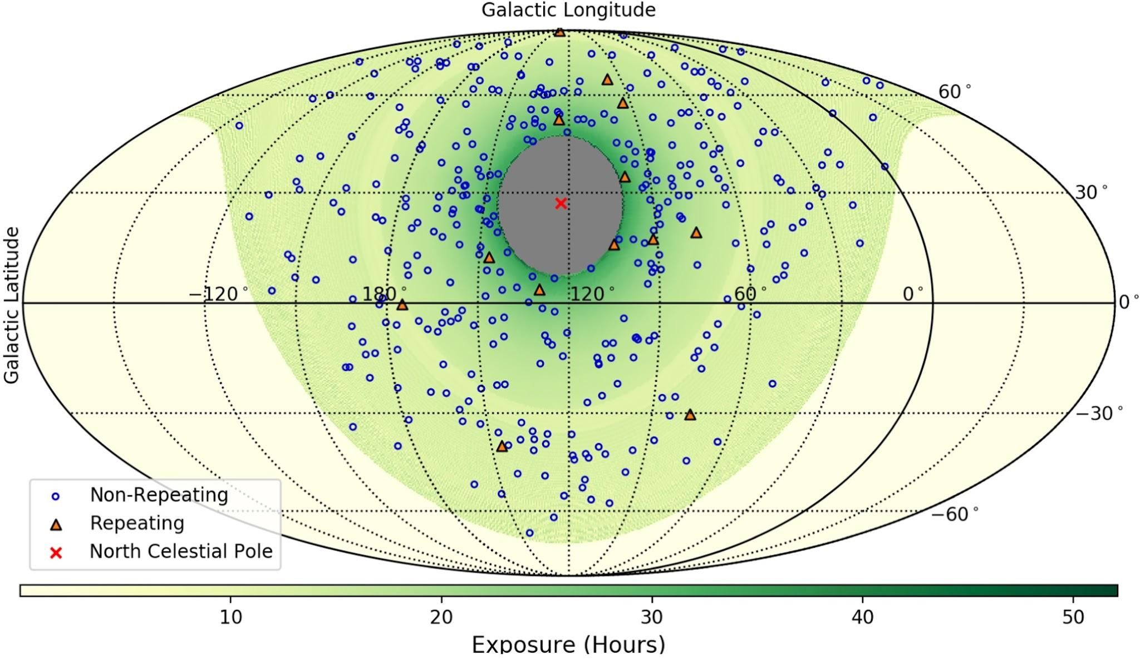
474 nonrepeating and 18 repeating (62 bursts) FRBs observed by CHIME in Galactic coordinates from 28 August 2018 to 1 July 2019.
(https://chime-frb-open-data.github.io)
Credit: CHIME/FRB Collaboration - https://iopscience.iop.org/article/10.3847/1538-4365/ac33ab

Slide 13
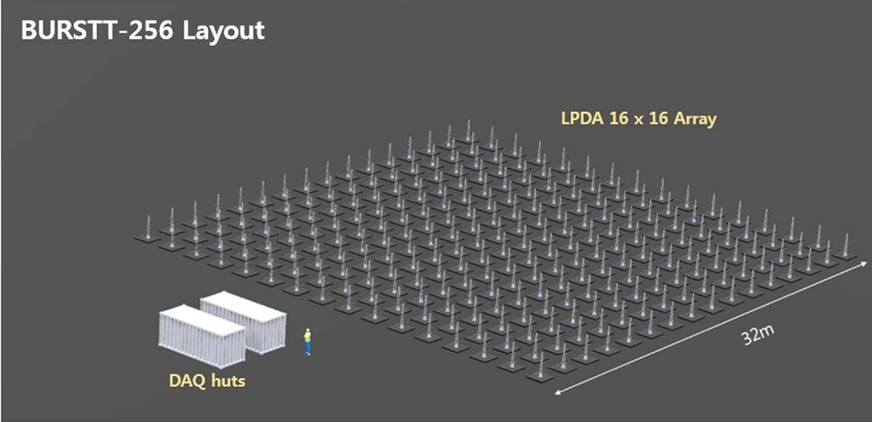
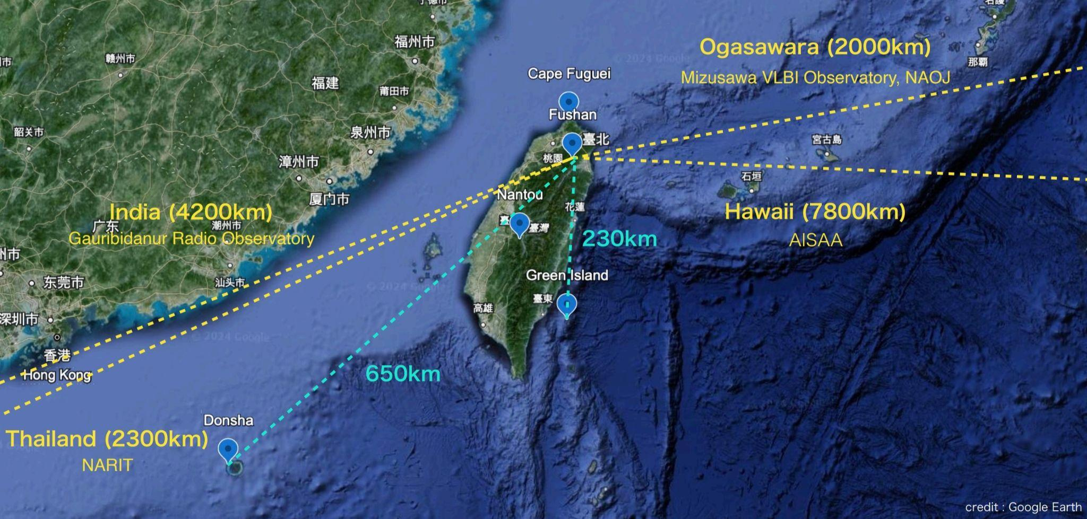
BURSTT
BURSTT is a unique fisheye radio software telescope in Taiwan dedicated to finding mysterious fast radio bursts (FRBs)
A scalable, dense core array of 256 to 2048 individual LPDA antennas.
Find bright, nearby FRBs and pinpoint their exact location to identify their host galaxy and enable follow-up by other telescopes (optical, X-ray, etc.).
Very Long Baseline Interferometry (VLBI). Uses "outrigger" stations hundreds or thousands of kilometers away (e.g., in Hawaii) to create extremely long baselines.

Slide 14
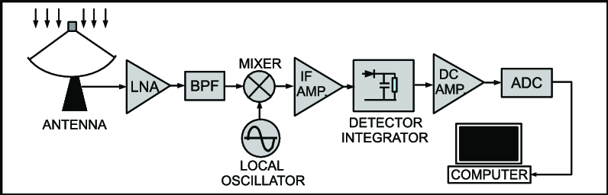
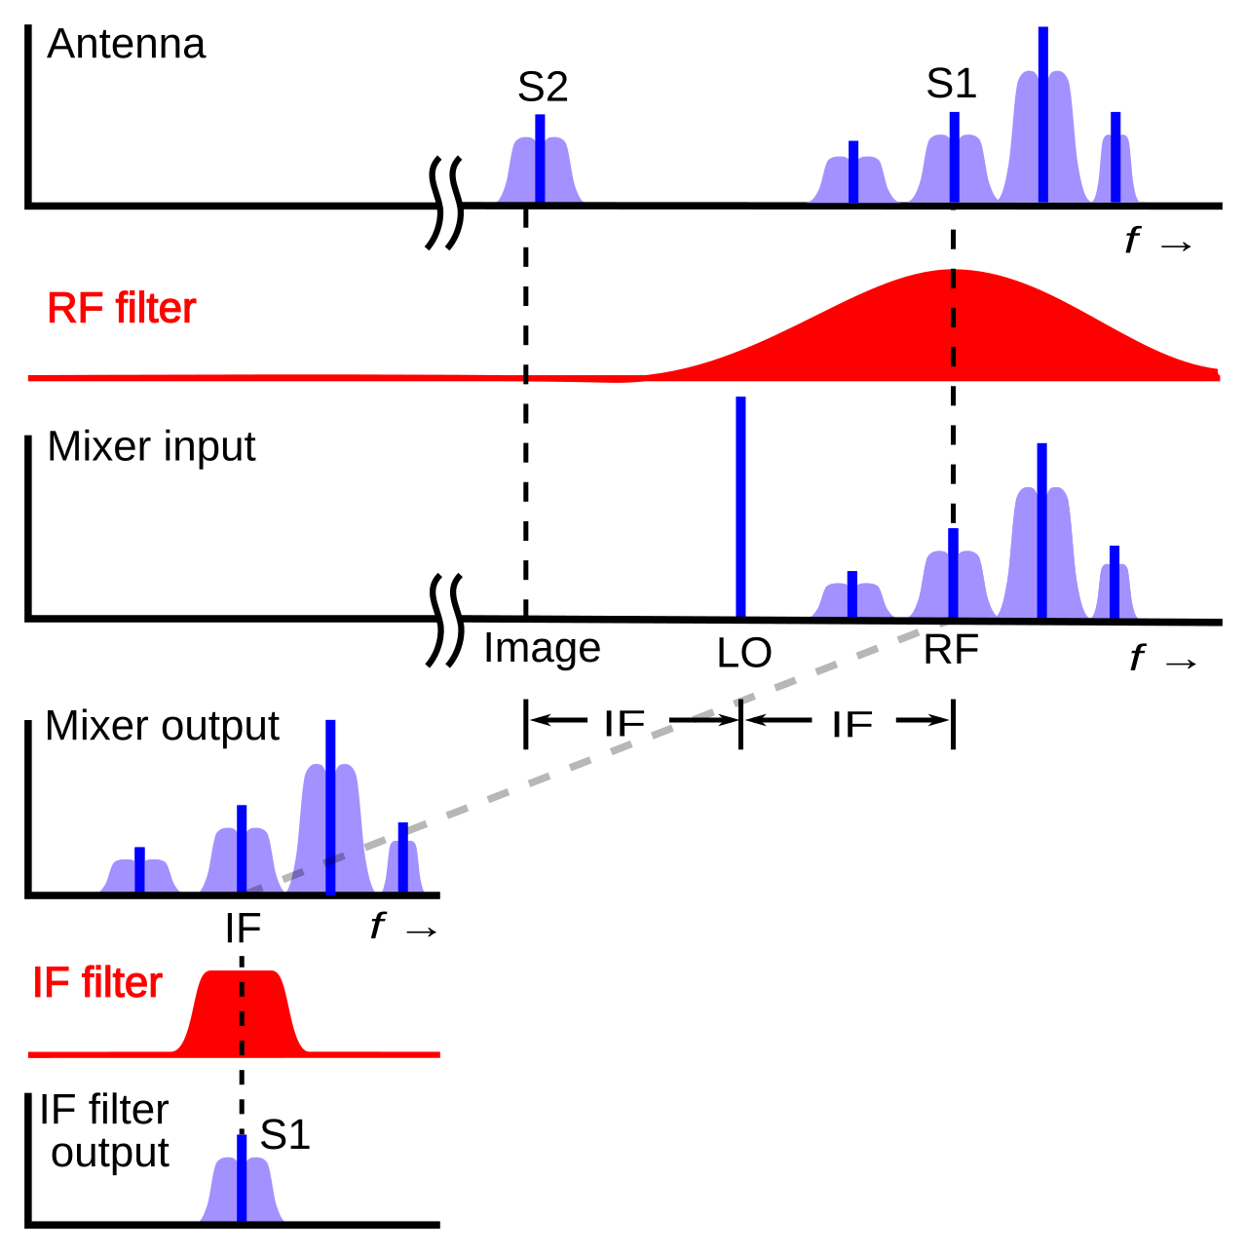
What is included in an antenna system?
Traditional Superheterodyne Receiver
=> Receive a high-frequency signal (e.g., a 450 MHz radio station) and process it with simpler, lower-frequency electronics
The Process:
RF Amplification (LNA): The weak 450 MHz signal from the antenna is amplified.
The Mixer:
takes the amplified 450 MHz signal as one input.
takes a second signal from a Local Oscillator (LO)—a very precise, tunable frequency generator. Let's say we tune the LO to 440 MHz.
The mixer "mixes" these two signals together. The output of a mixer contains both the sum (450 + 440 = 890 MHz) and the difference (450 - 440 = 10 MHz) of the input frequencies.
The IF Filter: A very sharp, high-quality filter centered at 10 MHz (the Intermediate Frequency, or IF) is placed after the mixer. This filter throws away the unwanted 890 MHz sum product and everything else, leaving only a perfect, clean 10 MHz signal that contains the original information from the 450 MHz station.
IF Amplification & Demodulation: This clean, stable 10 MHz IF signal is then much easier for the rest of the radio's electronics to amplify further and demodulate.

Slide 15
Modern Direct-Conversion SDR
RF Amplification (LNA): The chip has its own internal, programmable LNAs.
The Digital "Mixer": The AD9361 has an internal, digitally-controlled LO that is extremely agile. To receive at 450 MHz, it sets its internal LO to... 450 MHz!
Quadrature Demodulation: It mixes the incoming signal with two versions of the 450 MHz LO that are 90 degrees out of phase. This produces two outputs:
The I (In-phase) signal.
The Q (Quadrature) signal.
These I and Q signals are now at baseband (centered at 0 Hz). They contain the complete amplitude and phase information of the original 450 MHz signal.
Low-Pass Filtering & Digitization: These I and Q baseband signals are then passed through programmable low-pass filters (to set the channel bandwidth) and digitized by two separate, high-speed ADCs.

Slide 16
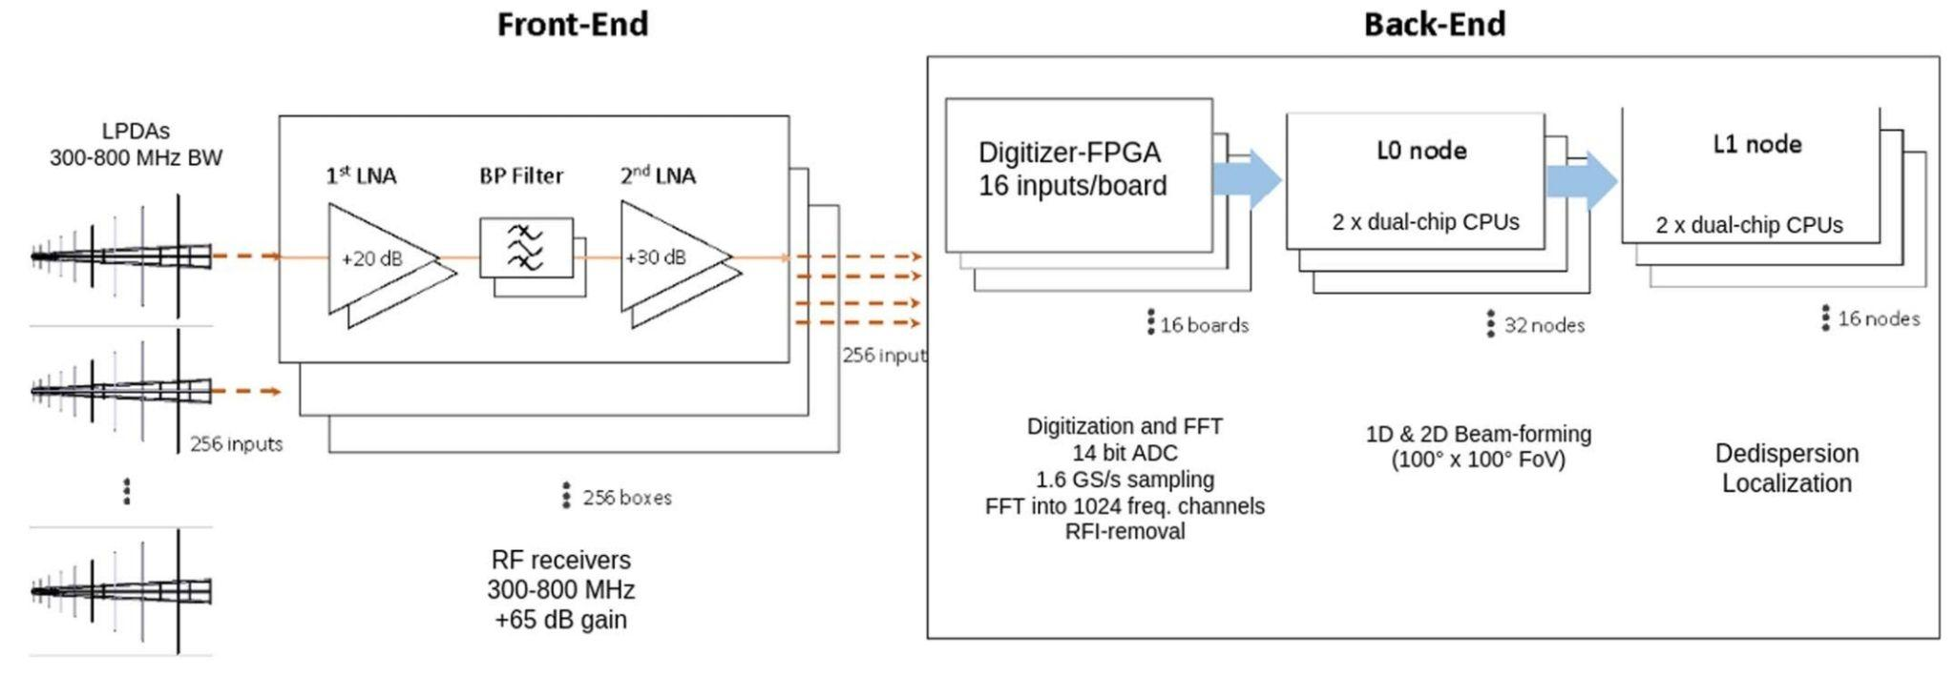
BURSTT’s hardware
The BURSTT hardware can be broken down into three main systems:
The Frontend: The analog system at each antenna that captures and prepares the faint radio signal.
The Backend: The massive digital "brain" at the main station that processes the signals in real-time.
The Outrigger System: The remote stations that enable precision localization.

Slide 17
The Front-end: The “ear” of the telescope
This is the system that exists at each of the 256 antennas in the main array.
Its only job is to capture the faint cosmic signal with the highest possible fidelity and send it to the backend.
It follows a classic high-dynamic-range, two-stage amplification design.

Slide 18
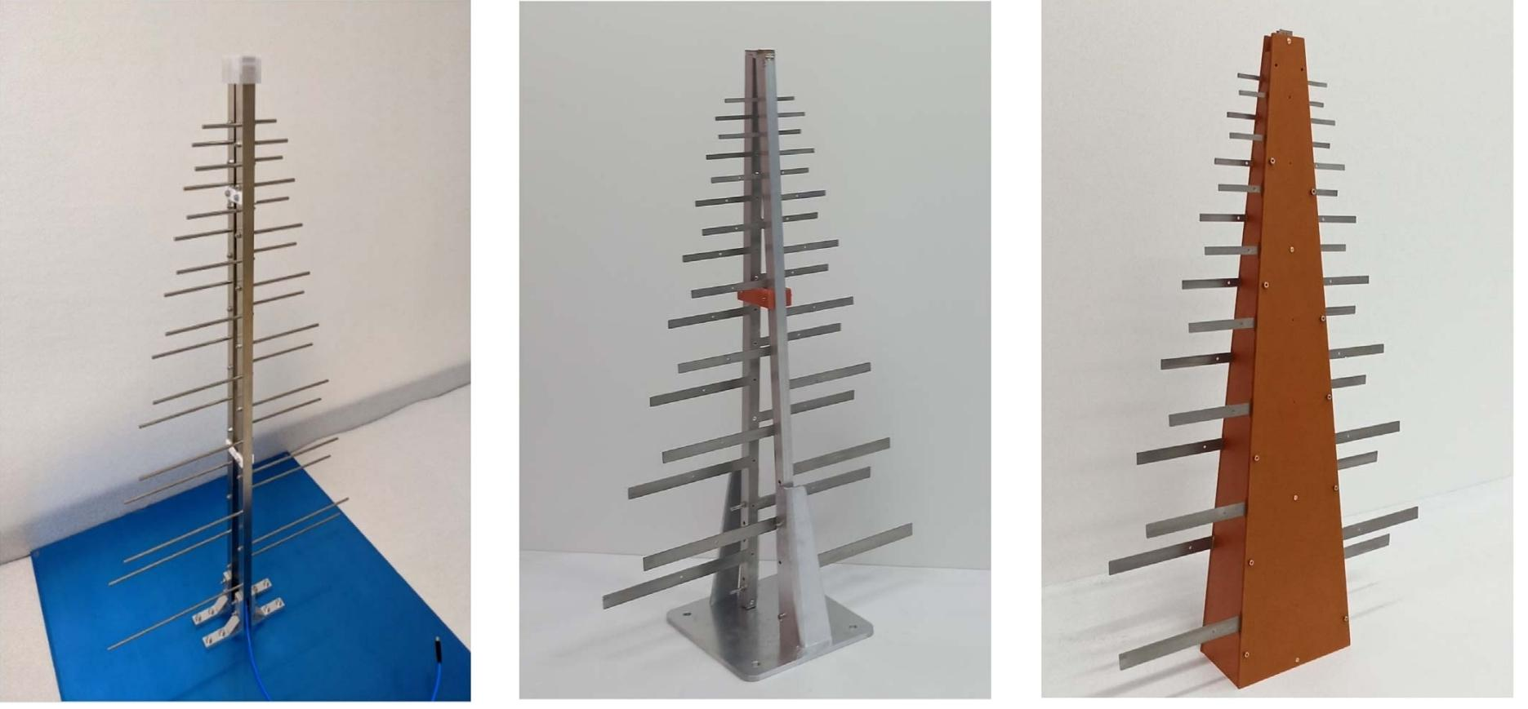
The Front-end: The “ear” of the telescope
LPDAs provide good, consistent gain (7-9 dBi) across the entire 300-800 MHz frequency band.
They are simple, mechanically robust (important for Taiwan's typhoon season), and highly directional.

Slide 19
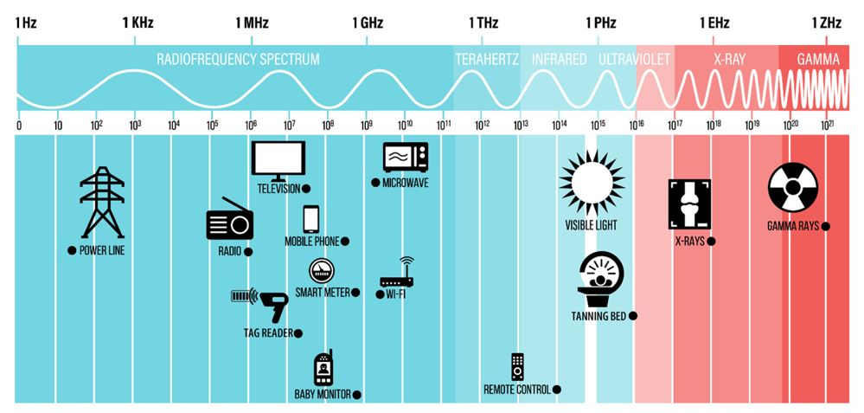
Radio Frequency Interference (RFI)
Source | Approximate frequency
AM | 530 - 1710 kHz
VHF (low) | 54 - 100 MHz
FM | 87.5 - 108 MHz
VHF (high) | 174 - 216 MHz
UHF | 470 - 806 MHz
GSM | 900 MHz, 1800 MHz
3G | 850 MHz, 900 MHz, 1900 MHz, 2100 MHz
4G | 700 MHz, 850 MHz, 1800 MHz, 2100 MHz, 2300 MHz, 2500 MHz

Slide 20
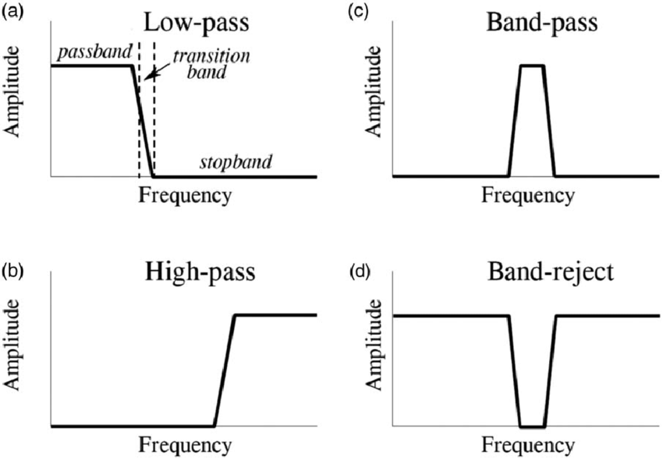
The Filters: The Gatekeeper Against Interference
HPF (High-Pass Filter): lets high frequencies pass through while blocking low frequencies (like FM radio).
LPF (Low-Pass Filter): lets low frequencies pass through while blocking high frequencies (like cellular and TV signals).
BPF (Band-Pass Filter): When place an HPF and an LPF in series (one after the other), their combined effect is to create a Band-Pass Filter. It only lets a specific "band" of frequencies pass through
BRF (Band-Reject Filter) / Notch Filter: This is the opposite of a BPF. It would be used to block a specific, narrow band of frequencies while letting everything else pass.
Notes:
The Problem: RFI. Show a real-world spectrum plot demonstrating how powerful FM radio and TV signals are compared to the cosmic noise floor.
The Solution: Explain the roles of a High-Pass Filter (HPF) and a Low-Pass Filter (LPF) to create a "band-pass" window for our desired 300-800 MHz signal.
Critical Placement: Emphasize that the filters must come before the amplifier. If you amplify first, the strong RFI will saturate the amplifier and destroy the faint cosmic signal.

Slide 21
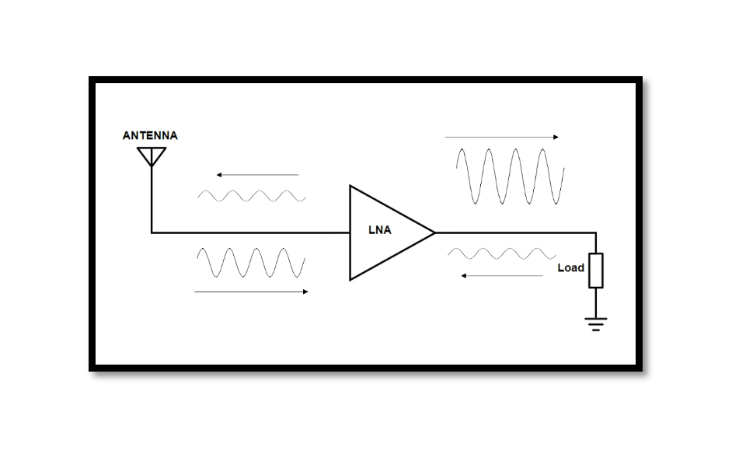
The LNA: The Heart of Sensitivity
The signal captured by the LPDA is incredibly weak. => We must amplify it before sending it down a long cable.
Amplifier: To amplify the whisper-faint cosmic signal before it is weakened by any other component.
The Requirement: The lowest possible Noise Figure. This amplifier's noise performance sets the sensitivity limit for the entire system.
Noise Figure (NF) is the ratio of the Signal-to-Noise Ratio (SNR) at the input to the Signal-to-Noise Ratio (SNR) at the output, expressed in decibels (dB).
NF (dB) = SNR_{input} (dB) - SNR_{output} (dB)
Notes:
Concept 1: The Need for Amplification. The signal captured by the LPDA is incredibly weak. We must amplify it before sending it down a long cable.
Concept 2: The Noise Figure (NF). Introduce the most important metric for an LNA. An amplifier adds its own "hiss" or noise. A lower Noise Figure means a quieter amplifier.
Analogy: It's like a microphone pre-amp so quiet it adds no background hiss. Our ZX60-P33ULN+ is a world-class "quiet" amplifier.
Critical Placement: Explain why the LNA must be mounted directly to the antenna. Every meter of cable between the antenna and the LNA adds signal loss, which permanently degrades your data. You must amplify the signal before this loss occurs.

Slide 22
LNA vs. ULN Amplifier
LNA (Low-Noise Amplifier): An LNA is any amplifier whose primary role is to be the very first active component in a receive chain, designed to amplify a weak signal while adding as little noise as possible. (NF= 0.8 to 1.5dB)
ULN (Ultra-Low Noise) Amplifier: NF<0.6dB
Feature | LNA (Standard, Good Performance) | ULN Amplifier (Ultra-Low Noise, Elite Performance)
Primary Goal | Provide gain with good noise performance. | Provide gain with the absolute lowest possible noise performance.
Typical Noise Figure (NF) | 0.8 dB to 1.5 dB | < 0.6 dB (often 0.3-0.5 dB)
Gain | Typically moderate to high (15-30 dB). | Often slightly lower gain (15-22 dB).
Linearity (Robustness to RFI) | Often higher. Designed for a good balance of noise and strength. | Often slightly lower. Performance is optimized for noise at the expense of linearity.
Technology | Standard GaAs or HEMT transistors. | Advanced pHEMT (Pseudomorphic High Electron Mobility Transistor) technology.
Cost | Moderate. | High. The advanced transistors and design are expensive.
Best Use Case | General-purpose amplification, second-stage amplification. | First-stage amplification right at the antenna feedpoint.

Slide 23
Why It's CRITICAL for the First LNA
The total Noise Figure of a system with multiple components in a chain (ex. LNA -> Filter -> Cable -> 2nd LNA) is dominated by the performance of the very first component.
The famous "Friis formula" for cascaded noise shows this, but the concept is simple:
Any noise added by the first amplifier gets amplified by all the subsequent stages.
This is why the placement and quality of the First-Stage LNA is the most important decision you will make. Its Noise Figure sets the noise performance for your entire radio telescope. Any noise it adds can never be removed. The noise from later components has a much smaller effect because the signal has already been significantly amplified.
Notes:
Concept 1: The Need for Amplification. The signal captured by the LPDA is incredibly weak. We must amplify it before sending it down a long cable.
Concept 2: The Noise Figure (NF). Introduce the most important metric for an LNA. An amplifier adds its own "hiss" or noise. A lower Noise Figure means a quieter amplifier.
Analogy: It's like a microphone pre-amp so quiet it adds no background hiss. Our ZX60-P33ULN+ is a world-class "quiet" amplifier.
Critical Placement: Explain why the LNA must be mounted directly to the antenna. Every meter of cable between the antenna and the LNA adds signal loss, which permanently degrades your data. You must amplify the signal before this loss occurs.

Slide 24
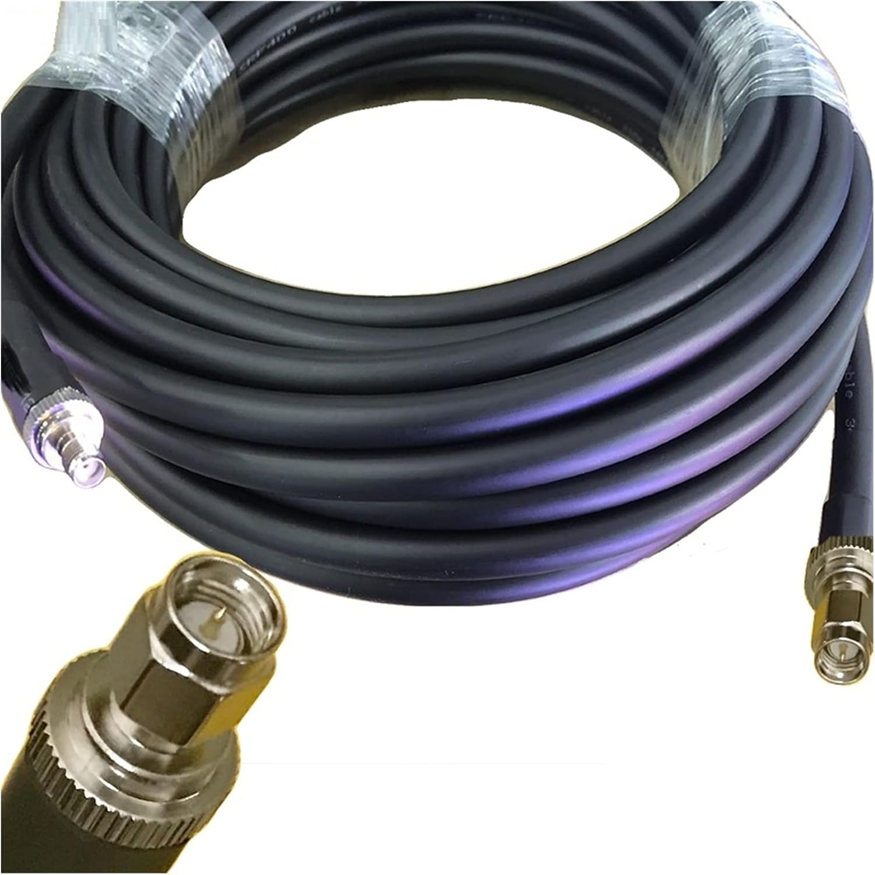
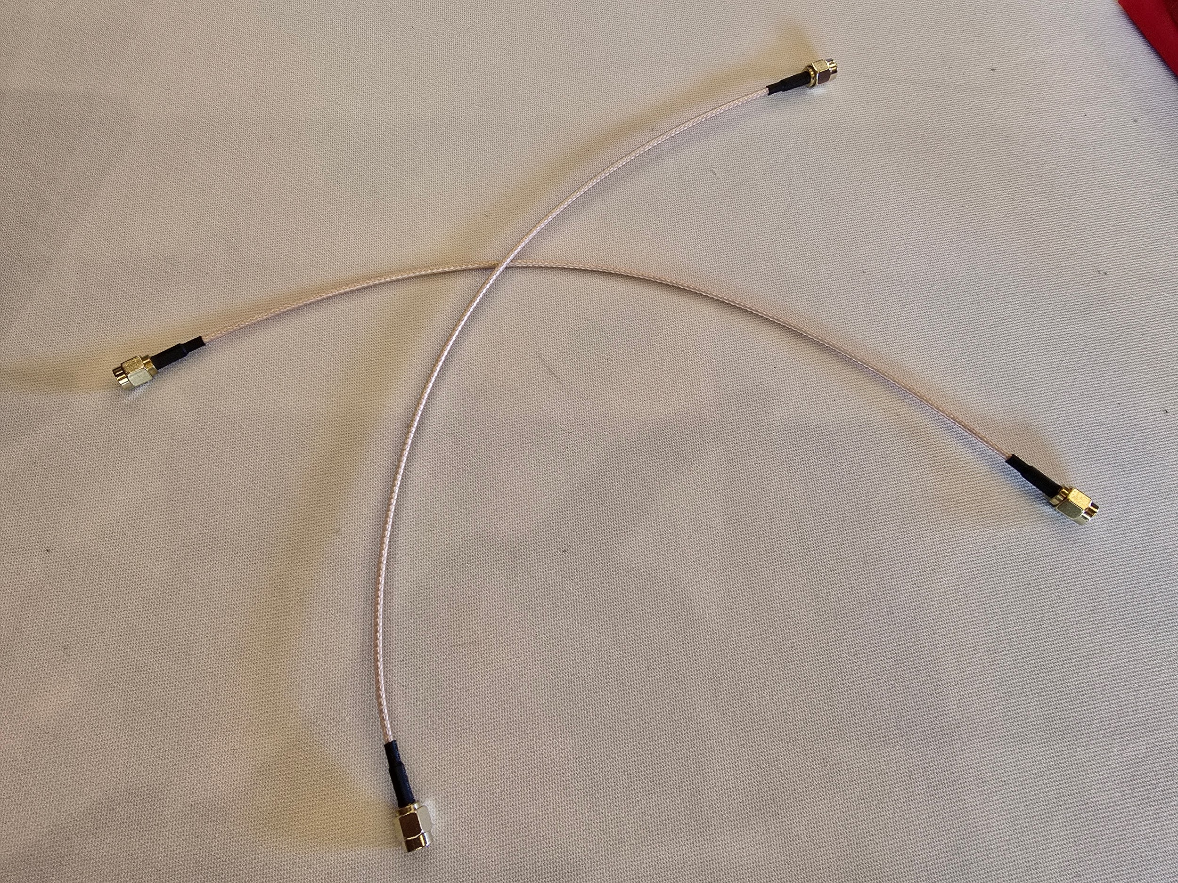
Cabling and Power
Using the wrong cable can silently destroy your faint cosmic signal, rendering your expensive, high-performance electronics completely useless. The importance of cabling comes down to one primary factor: unrecoverable signal loss.
Imagine your faint astronomical signal is a tiny, precious drop of a rare liquid that you have collected in a bucket (your antenna). Your goal is to transport this single drop from the bucket, across a field, to a laboratory for analysis (your receiver).
The cable is the pipe you use to transport it.
Notes:
Cables: Briefly explain that all cables have loss, which is why we use low-loss types like LMR-400 for the long run to the control room.
Powering the LNA: Introduce the Bias Tee. Explain this clever device allows us to send the clean DC power up the same coaxial cable that the amplified RF signal is coming down, eliminating the need for a separate, noisy power cable running up the mast.

Slide 25
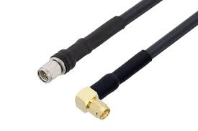
Loss Before Amplification (The Most Critical Stage)
This is the short jumper cable between your antenna and your first Low-Noise Amplifier (LNA).
Every decibel of loss in the cable before the first LNA directly adds to the Noise Figure of your entire system. If you use a poor-quality cable with 1 dB of loss here, you have just made your entire multi-thousand-dollar telescope system 1 dB "noisier" (i.e., less sensitive). This loss is permanent and can never be recovered.
The Right Choice: ultra-low-loss, flexible cable like LMR-240-UF or a high-quality Mini-Circuits Hand-Flex jumper. The goal is to make this "pipe" as short and as perfectly sealed as possible.

Slide 26
Loss After Amplification (The Long Run)
This is the long cable that runs from your mast-mounted LNA down to your indoor lab. At this point, the LNA has already amplified your "single drop" into a full cup of liquid.
The Physics: The signal is now strong, but the long cable still introduces significant attenuation (loss). The goal is to preserve as much of that amplified signal as possible.
A 15-meter run of RG-58 would lose about -10 dB at 700 MHz. You would lose 90% of your signal.
A 15-meter run of LMR-400 loses only about -2.1 dB. You preserve over 60% of your signal.
The Right Choice: This is why LMR-400 (or an equivalent) is the non-negotiable choice for this long run. The difference in signal preservation is not small; it's a factor of hundreds of percent.

Slide 27
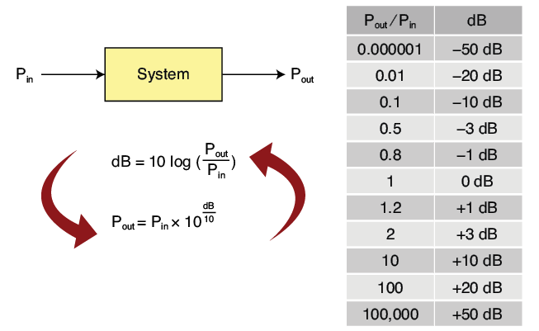
Signal Loss and Gain
First, we need to understand the unit we use. We use the decibel (dB) because it's a logarithmic scale that makes it easy to add and subtract gains and losses.
Gain (Positive dB):
+3 dB = 2x the power
+10 dB = 10x the power
+20 dB = 100x the power
Loss (Negative dB):
-3 dB = 1/2 the power (50% loss)
-10 dB = 1/10th the power (90% loss)
-20 dB = 1/100th the power (99% loss)

Slide 28
Tracing the Signal: A Journey of Loss and Gain
Let's assume the raw signal power captured by the antenna is -110 dBm (a common power level for a faint radio source).
[Antenna] -> [LNA] -> [Filter] -> [2nd LNA] -> [Long Cable]
The Antenna (LPDA)
Function: Captures the signal and provides directional gain.
Effect: A good LPDA has a gain of about +7 dBi. This focuses the energy, effectively boosting the signal relative to noise from other directions.
Signal Level: -110 dBm + 7 dB = -103 dBm
The Jumper Cable & Filter
Function: These are passive components. They don't add power; they only take it away. This is insertion loss.
Effect: A short jumper and a good filter might have a combined loss of -1.0 dB. This is unavoidable loss before our first amplifier.
Signal Level: -103 dBm - 1.0 dB = -104 dBm
CRITICAL POINT: The Signal-to-Noise Ratio is now permanently set. The signal is at its absolute weakest point relative to the background thermal noise.

Slide 29
Tracing the Signal: A Journey of Loss and Gain
Let's assume the raw signal power captured by the antenna is -110 dBm (a common power level for a faint radio source).
[Antenna] -> [Filter] -> [LNA] -> [Long Cable]
3. The First-Stage LNA (ULN amp)
Function: This is our first and most important source of gain. Its job is to dramatically strengthen the signal.
Effect: A typical Mini-Circuits ZX60-P33ULN+ has a gain of about +20 dB.
Signal Level: -104 dBm + 20 dB = -84 dBm
The signal is now much stronger, but the LNA has also added its own tiny bit of noise (its Noise Figure).
4. The Long LMR-400 Cable (15 meters)
Function: This is a major source of loss.
Effect: As we calculated, a 15m run of LMR-400 at these frequencies has a loss of about -2.1 dB.
Signal Level: -84 dBm - 2.1 dB = -86.1 dBm
This is why we amplify before the long cable. If we didn't, the -104 dBm signal would drop to -106.1 dBm, making it much harder to distinguish from noise later on.

Slide 30
The "Signal Budget" Summary
Component | Gain/Loss (dB) | Cumulative Signal Level (dBm)
Initial Signal | --- | -110.0
Antenna Gain | +7.0 | -103.0
Filter/Jumper Loss | -1.0 | -104.0 (SNR is now fixed)
LNA Gain | +20.0 | -84.0
Long Cable Loss | -2.1 | -86.1
Bias Tee/Jumper Loss | -0.5 | -86.6
Final Level at SDR | --- | -86.6

Slide 31
Why the Two-Stage Amplification is Better
Now, imagine the professional two-stage system from the BURSTT system.
The first LNA provides +20 dB of gain.
The signal suffers the -2.1 dB of cable loss.
The second LNA (indoors) provides another +30 dB of gain.
The final signal arriving at the SDR would be -68.6 dBm, which is 100 times more powerful than in the single-stage system. This much stronger signal is easier for the SDR to digitize accurately and is far more resilient to any electronic noise generated inside the NUC computer case.

Slide 32
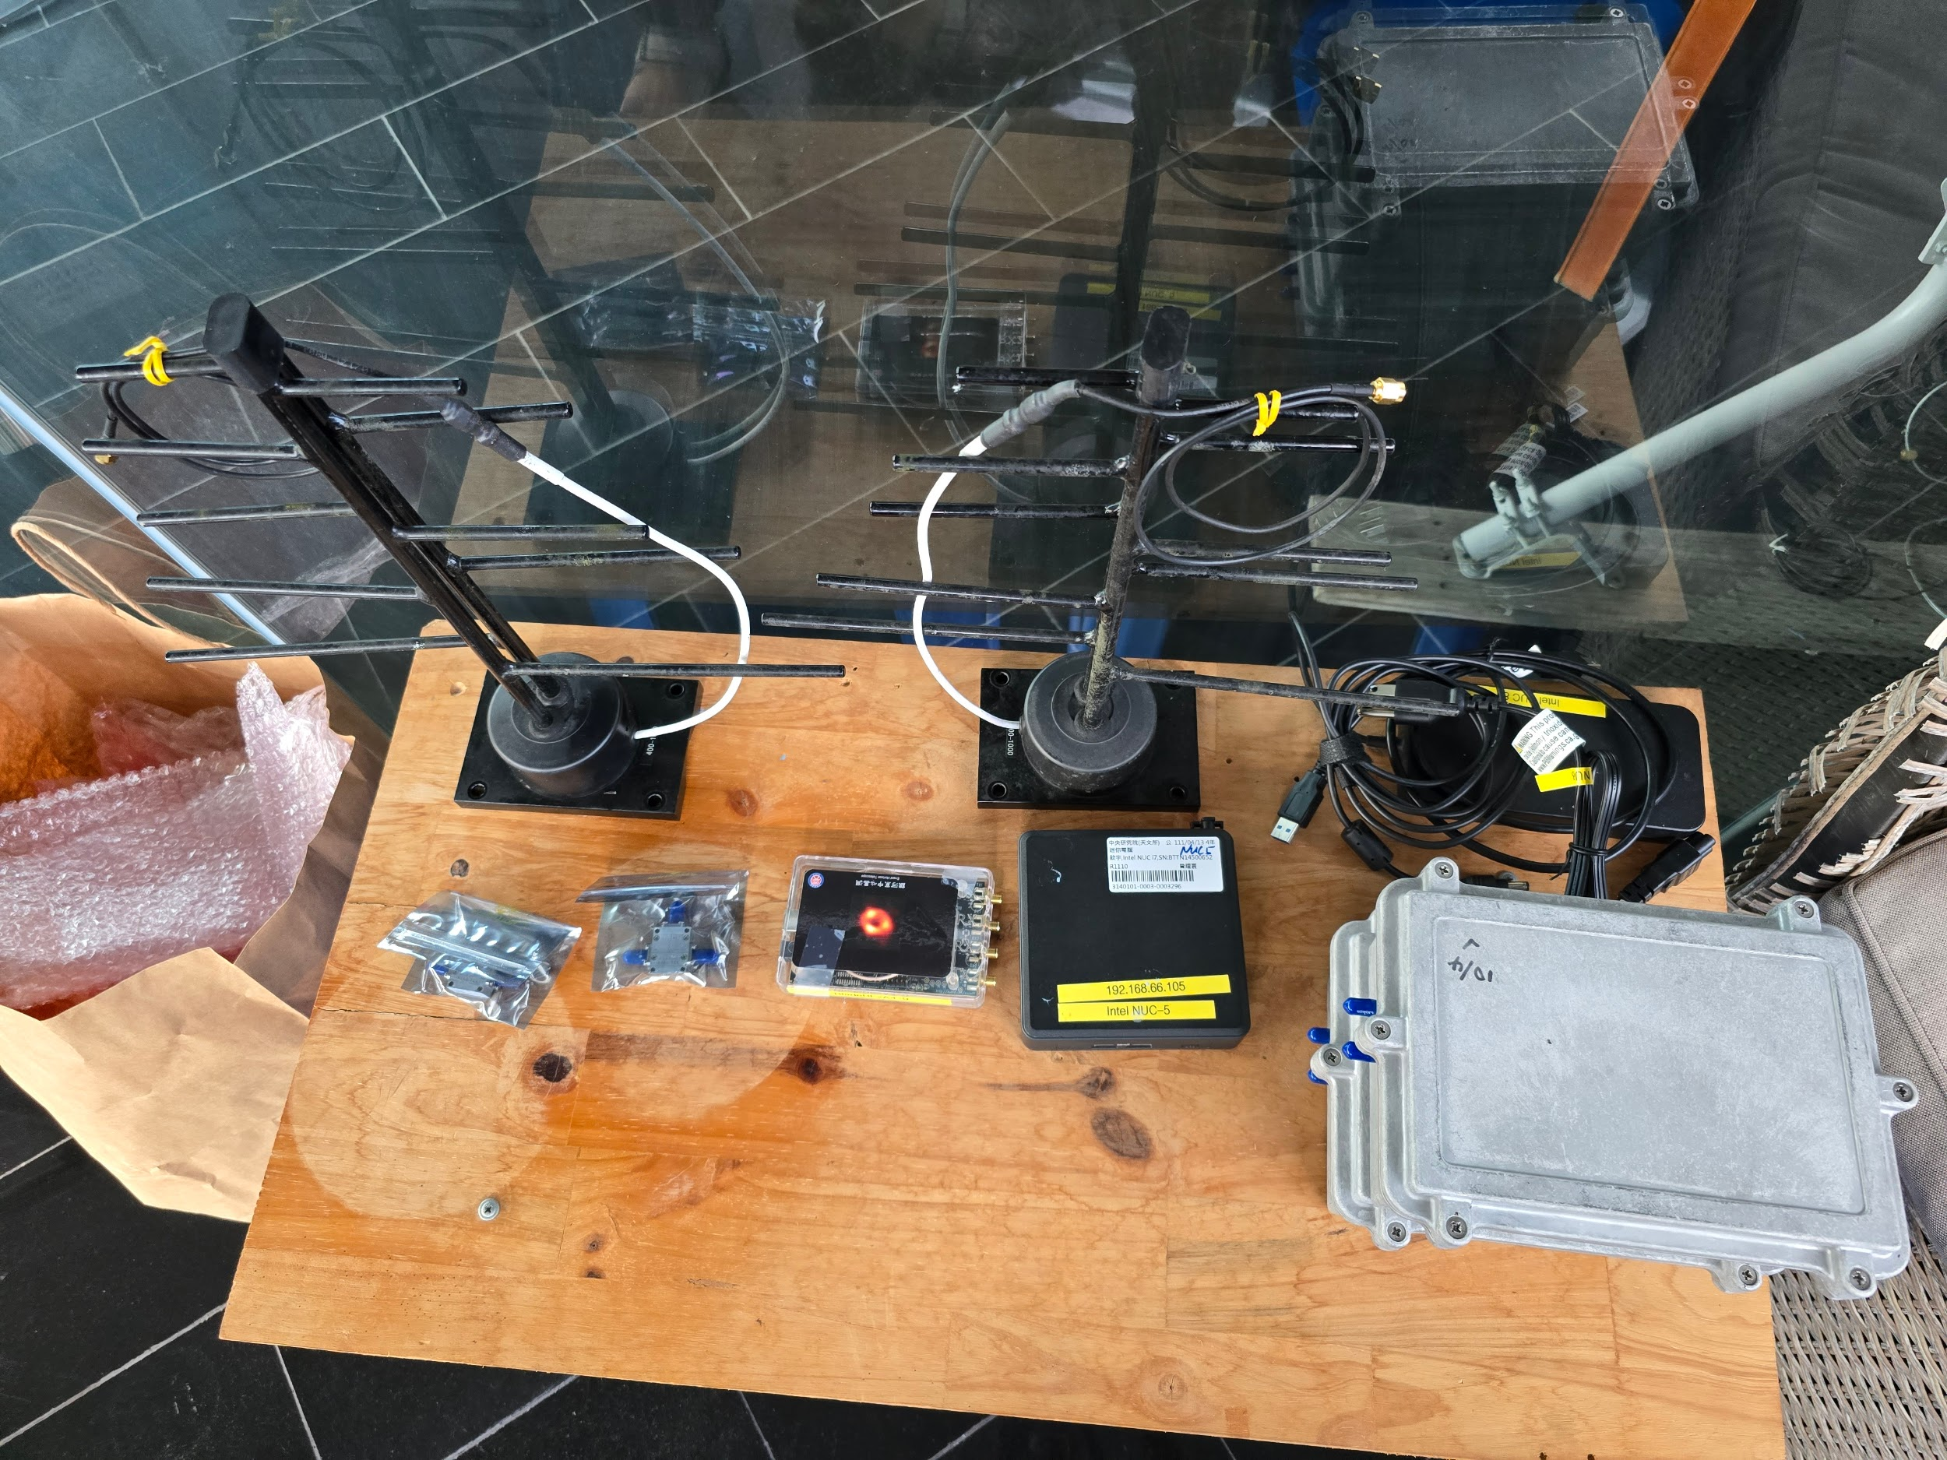
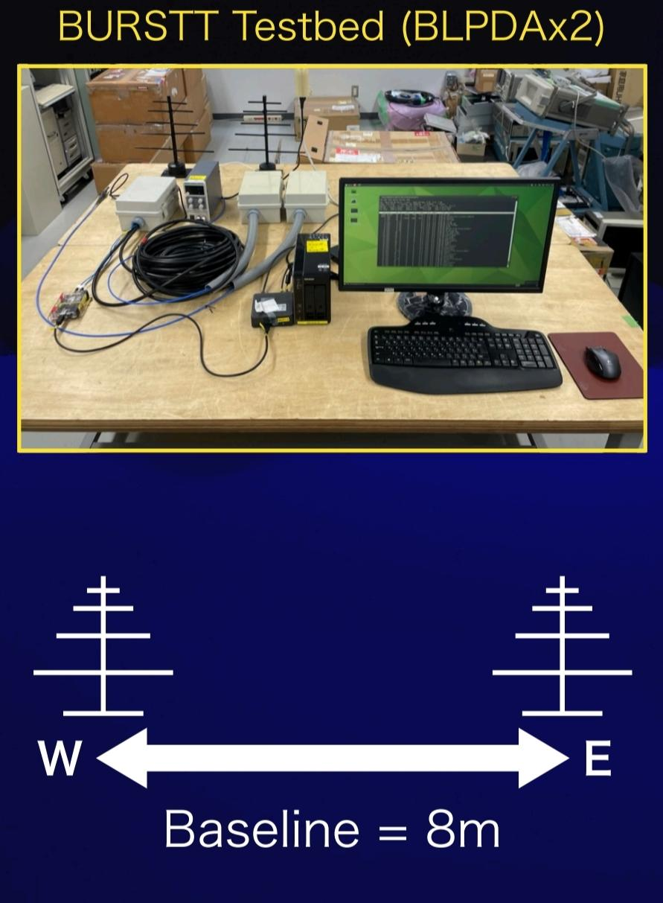
BURSTT Testbed
Image: Hiroto 2024.

Slide 33
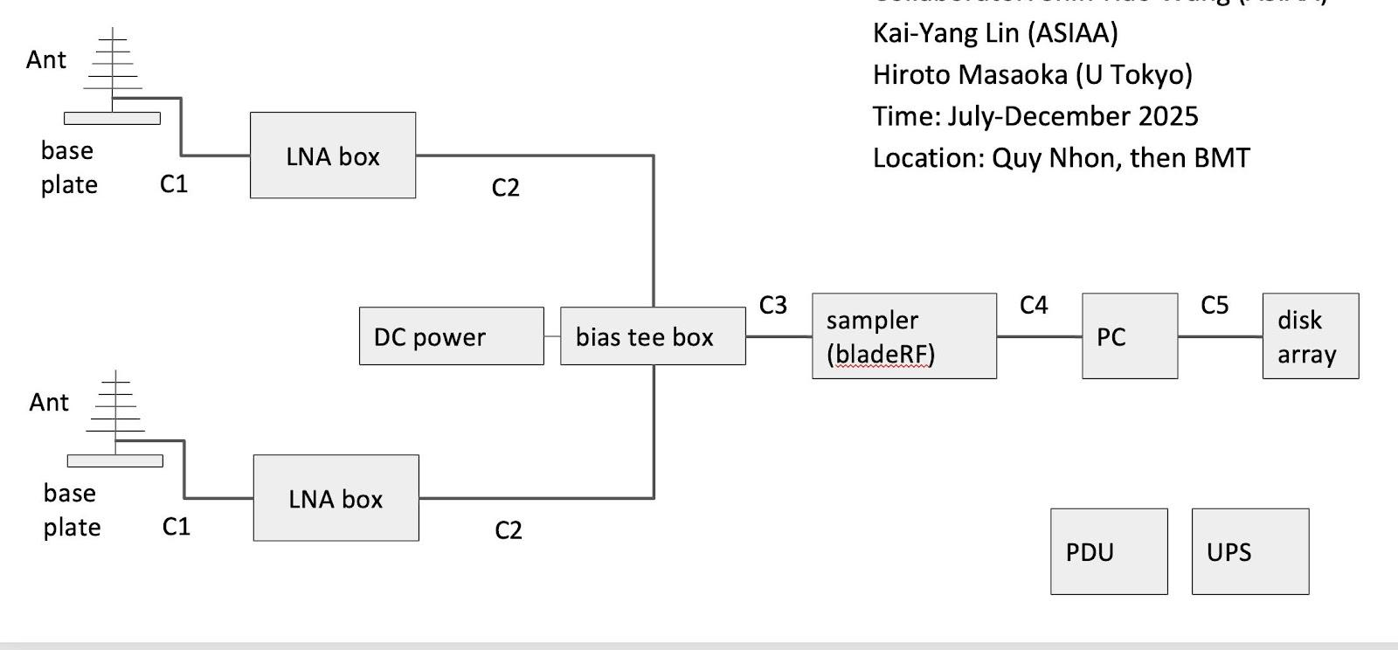
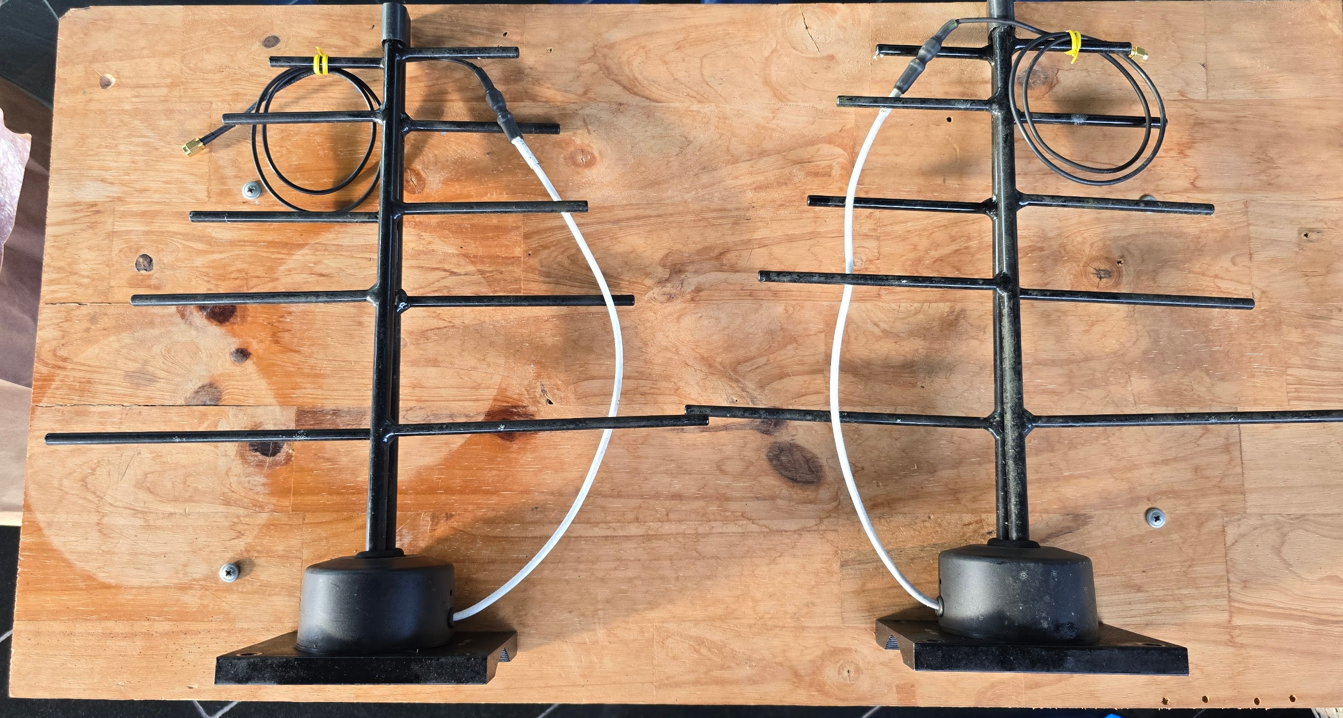
Conclusion & Project Kick-off
Set up 01 antenna system and make observations. What should be improved?
STT | Component | Model | Notes | Qty | Unit
1 | Antenna | LPDA | Provides 4-7 dBi gain across the 300-800 MHz band. | 2 | item
2 | LNA | Mini-Circuits ZX60-P33ULN+ | 50Ω, 0.4 to 3.0 GHz, Ultra Low Noise Figure, world-class ~0.45 dB Noise Figure and ~19 dB gain in the range. | 2 | item
3 | Bias Tee | 0.1-4.2GHz | Powers the LNA. excellent low insertion loss (~0.3 dB), high current capacity (500mA) | 4 | item
4 | SDR Sampler | Nuand bladeRF 2.0 micro xA4 | Dual-channel, phase-coherent receiver. The xA4's FPGA is crucial for future on-device processing and data reduction. | 1 | item
5 | Mini-PC Kit | intel NUC i7 |  | 1 | item
6 | Cable (main run) | LMR-400 | 15m | 1 | item

Slide 34
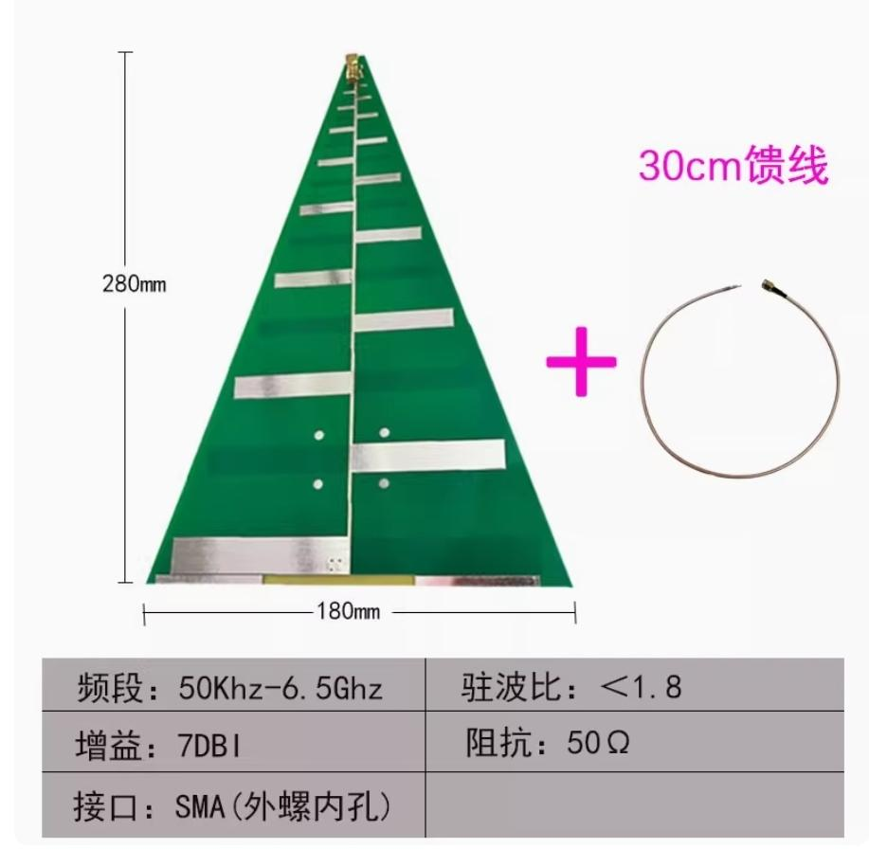
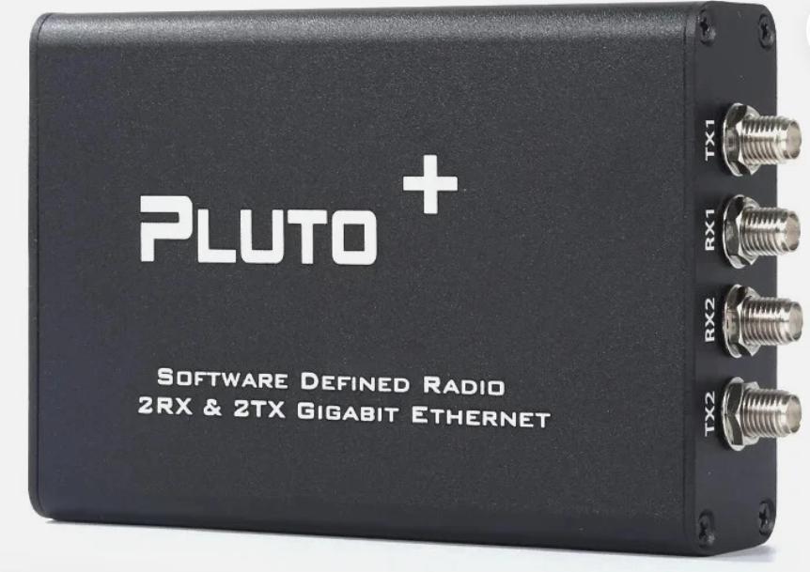
The alternative system
 | Type | Name
1 | Balun | adf4350 ADF4355 balun 1:1 100KHZ-3GHZ | 3GHz | 2
2 | Bias Tee | 10M-6GHz low insertion loss | 0.01 - 6GHz | 4
3 | Bandpass filter | 205-700MHz broadband bandpass filter, SMA interface | 205 - 700MHz | 2
4 | SDR | Pluto+ (Zynq7010, AD9361) | 70mhz~6GHz | 1
5 | LPDA antenna | Logarithmic periodic dipole array (LPDA): directional high gain ultra-wideband PCD antenna | 50KHz - 6.5GHz | 2
6 | Amplifier | 2025 Ultra Low Noise Amplifier, NF=0.3, 0.1-6GHz | 0.1 - 6GHz. | 2
7 | Cable | RG316, SMA-JJ SMA male to male | 18cm
8 | Cable | LMR-400 SMA male to male | 15m | 2

Slide 35
To be continued…

